Slide 1
Chapter 4 Digital Transmission
Reference:
Data Communication and Networking, Behrouz A.Forouzan, McGraw Hill, 5th Edition, 2008

Slide 2
4.1 DIGITAL-TO-DIGITAL CONVERSION
Represent digital data by using digital signals.
The conversion involves three techniques:
line coding,
block coding, and
scrambling.
Line coding is always needed; block coding and scrambling may or may not be needed.

Slide 3
4.1.1 Line Coding
Line coding is the process of converting digital data to digital signals.
We assume that data, in the form of text, numbers, graphical images, audio, or video, are stored in computer memory as sequences of bits
Line coding converts a sequence of bits to a digital signal.
At the sender, digital data are encoded into a digital signal; at the receiver, the digital data are recreated by decoding the digital signal.
Figure 4.1 shows the process.

Slide 4
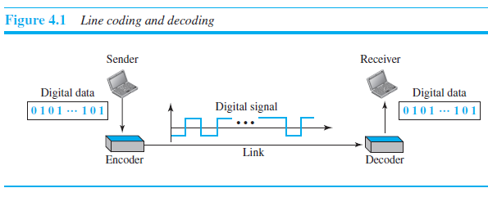
4.1.1 Line Coding Contd.

Slide 5
4.1.1 Line Coding Contd.
Characteristics
Before discussing different line coding schemes, we address their common characteristics.
Signal Element Versus Data Element
In data communications, our goal is to send data elements.
A data element is the smallest entity that can represent a piece of information: this is the bit.
In digital data communications, a signal element carries data elements.
A signal element is the shortest unit (timewise) of a digital signal.
In other words, data elements are what we need to send; signal elements are what we can send.
Data elements are being carried; signal elements are the carriers.

Slide 6
4.1.1 Line Coding Contd.
We define a ratio r which is the number of data elements carried by each signal element.
Figure 4.2 shows several situations with different values of r.
In part a of the figure, one data element is carried by one signal element (r = 1).
In part b of the figure, we need two signal elements (two transitions) to carry each data element (r = 1/2 ).
In part c of the figure, a signal element carries two data elements (r = 2).
Finally, in part d, a group of 4 bits is being carried by a group of three signal elements (r = 4/3).

Slide 7
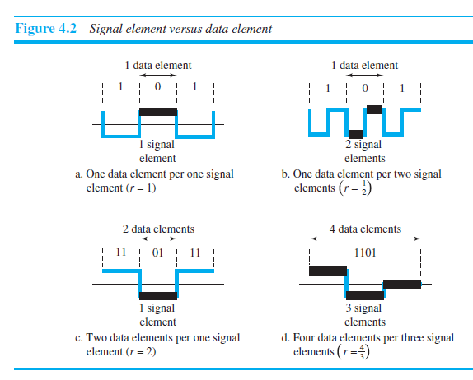
4.1.1 Line Coding Contd.

Slide 8
4.1.1 Line Coding Contd.
Data Rate Versus Signal Rate
The data rate defines the number of data elements (bits) sent in 1s.
The unit is bits per second (bps).
The signal rate is the number of signal elements sent in 1s.
The unit is the baud.
The data rate is sometimes called the bit rate; the signal rate is sometimes called the pulse rate, the modulation rate, or the baud rate.

Slide 9
4.1.1 Line Coding Contd.
One goal in data communications is to increase the data rate while decreasing the signal rate.
Increasing the data rate increases the speed of transmission; decreasing the signal rate decreases the bandwidth requirement.
We now need to consider the relationship between data rate (N) and signal rate (S)
S = N/r
in which r has been previously defined.
This relationship, of course, depends on the value of r.
It also depends on the data pattern. If we have a data pattern of all 1s or all 0s, the signal rate may be different from a data pattern of alternating 0s and 1s. To

Slide 10

4.1.1 Line Coding Contd.
To derive a formula for the relationship, we need to define three cases: the worst, best, and average.
The worst case is when we need the maximum signal rate; the best case is when we need the minimum. In data communications, we are usually interested in the average case.
We can formulate the relationship between data rate and signal rate as
where N is the data rate (bps); c is the case factor, which varies for each case; S is the number of signal elements per second; and r is the previously defined factor.

Slide 11
4.1.1 Line Coding Contd.
Example 4.1
A signal is carrying data in which one data element is encoded as one signal element (r = 1). If the bit rate is 100 kbps, what is the average value of the baud rate if c is between 0 and 1?

Slide 12
4.1.1 Line Coding Contd.
Example 4.1
A signal is carrying data in which one data element is encoded as one signal element (r = 1). If the bit rate is 100 kbps, what is the average value of the baud rate if c is between 0 and 1?
We assume that the average value of c is 1/2. The baud rate is then

Slide 13
4.1.1 Line Coding Contd.
Bandwidth
Digital signal that carries information is nonperiodic.
The bandwidth of a nonperiodic signal is continuous with an infinite range.
However, most digital signals we encounter in real life have a bandwidth with finite values.
In other words, the bandwidth is theoretically infinite, but many of the components have such a small amplitude that they can be ignored.
The effective bandwidth is finite.

Slide 14


4.1.1 Line Coding Contd.
We can say that the baud rate, not the bit rate, determines the required bandwidth for a digital signal.
More changes in the signal mean injecting more frequencies into the signal.
There is a relationship between the baud rate (signal rate) and the bandwidth. Bandwidth (range of frequencies) is proportional to the signal rate (baud rate).
The minimum bandwidth can be given as
We can solve for the maximum data rate if the bandwidth of the channel is given.

Slide 15

4.1.1 Line Coding Contd.
Example 4.2
The maximum data rate of a channel is Nmax = 2 × B × log2 L (defined by the Nyquist formula). Does this agree with the previous formula for Nmax?
Solution
A signal with L levels actually can carry log2 L bits per level. If each level corresponds to one signal element and we assume the average case (c = 1/2), then we have

Slide 16
4.1.1 Line Coding Contd.
Baseline Wandering
In decoding a digital signal, the receiver calculates a running average of the received signal power.
This average is called the baseline.
The incoming signal power is evaluated against this baseline to determine the value of the data element.
A long string of 0s or 1s can cause a drift in the baseline (baseline wandering) and make it difficult for the receiver to decode correctly.
A good line coding scheme needs to prevent baseline wandering.

Slide 17
4.1.1 Line Coding Contd.
DC Components
When the voltage level in a digital signal is constant for a while, the spectrum creates very low frequencies (results of Fourier analysis).
These frequencies around zero, called DC (direct-current) components, present problems for a system that cannot pass low frequencies or a system that uses electrical coupling (via a transformer).
We can say that DC component means 0/1 parity that can cause base-line wondering.
For example, a telephone line cannot pass frequencies below 200 Hz.
For these systems, we need a scheme with no DC component.

Slide 18
4.1.1 Line Coding Contd.
Self-synchronization
To correctly interpret the signals received from the sender, the receiver’s bit intervals must correspond exactly to the sender’s bit intervals.
If the receiver clock is faster or slower, the bit intervals are not matched and the receiver might misinterpret the signals.
Figure 4.3 shows a situation in which the receiver has a shorter bit duration.
The sender sends 10110001, while the receiver receives 110111000011.
A self-synchronizing digital signal includes timing information in the data being transmitted.
This can be achieved if there are transitions in the signal that alert the receiver to the beginning, middle, or end of the pulse.
If the receiver’s clock is out of synchronization, these points can reset the clock.

Slide 19
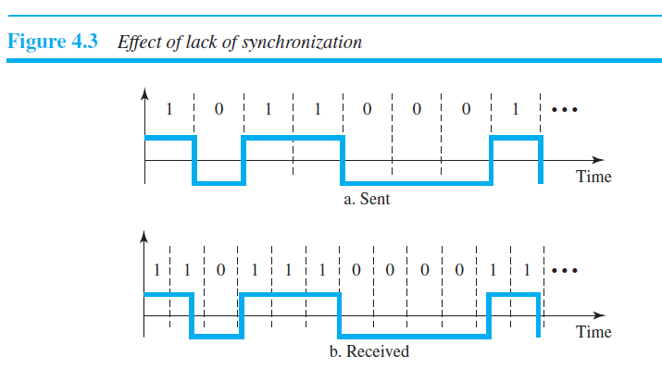
4.1.1 Line Coding Contd.

Slide 20
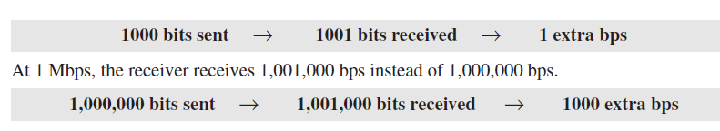
4.1.1 Line Coding Contd.
Example 4.3
In a digital transmission, the receiver clock is 0.1 percent faster than the sender clock. How many extra bits per second does the receiver receive if the data rate is 1 kbps? How many if the data rate is 1 Mbps?
Solution
At 1 kbps, the receiver receives 1001 bps instead of 1000 bps.

Slide 21
In a digital transmission, the sender clock is 0.2 percent faster than the receiver clock. How many extra bits per second does the sender send if the data rate is 1 Mbps?

Slide 22

In a digital transmission, the sender clock is 0.2 percent faster than the receiver clock. How many extra bits per second does the sender send if the data rate is 1 Mbps?

Slide 23
4.1.1 Line Coding Contd.
Built-in Error Detection
It is desirable to have a built-in error-detecting capability in the generated code to detect some or all of the errors that occurred during transmission. Some encoding Schemes have this capability to some extent.
Immunity to Noise and Interference
Another desirable code characteristic is a code that is immune to noise and other interferences.
Some encoding schemes have this capability.
Complexity
A complex scheme is more costly to implement than a simple one. For example, a scheme that uses four signal levels is more difficult to interpret than one that uses only two levels.

Slide 24
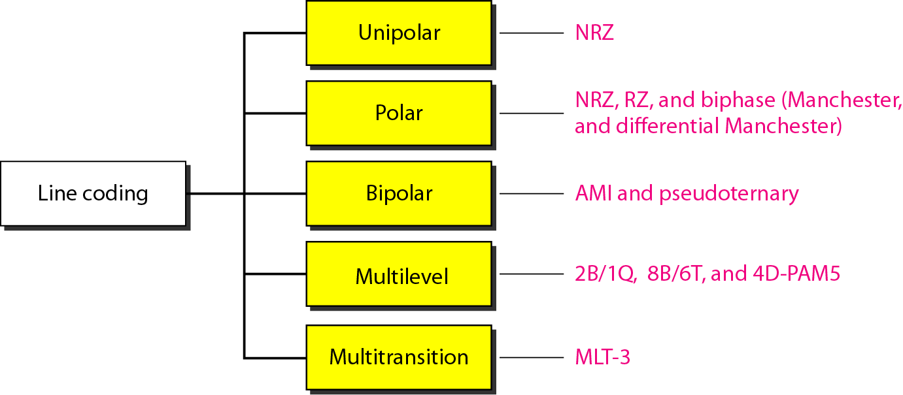
4.1.2 Line Coding Schemes
We can roughly divide line coding schemes into five broad categories, as shown in Figure 4.4.
Figure 4.4 Line coding schemes

Slide 25
4.1.2 Line Coding Schemes Contd.
Unipolar Scheme
In a unipolar scheme, all the signal levels are on one side of the time axis, either above or below.
NRZ (Non-Return-to-Zero)
Traditionally, a unipolar scheme was designed as a non-return-to-zero (NRZ) scheme in which the positive voltage defines bit 1 and the zero voltage defines bit 0.
It is called NRZ because the signal does not return to zero at the middle of the bit. Figure 4.5 shows a unipolar NRZ scheme.
Compared with its polar counterpart, this scheme is very costly.
The normalized power (the power needed to send 1 bit per unit line resistance) is double than that for polar NRZ. For this reason, this scheme is normally not used in data communications today.

Slide 26
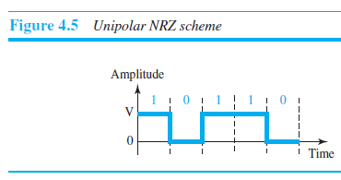
4.1.2 Line Coding Schemes Contd.

Slide 27
4.1.2 Line Coding Schemes Contd.
Polar Schemes
In polar schemes, the voltages are on both sides of the time axis.
For example, the voltage level for 0 can be positive and the voltage level for 1 can be negative.
Non-Return-to-Zero (NRZ)
In polar NRZ encoding, we use two levels of voltage amplitude.
We can have two versions of polar NRZ: NRZ-L and NRZ-I, as shown in Figure 4.6.
In the first variation, NRZ-L (NRZ-Level), the level of the voltage determines the value of the bit.
In the second variation, NRZ-I (NRZ-Invert), the change or lack of change in the level of the voltage determines the value of the bit.
If there is no change, the bit is 0; if there is a change, the bit is 1.

Slide 28
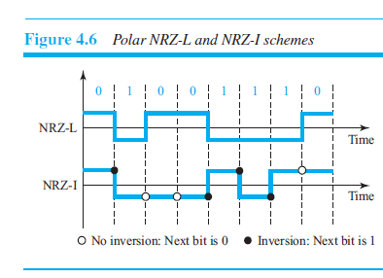
4.1.2 Line Coding Schemes Contd.

Slide 29
Draw the graph of the NRZ-L, NRZ-I, using each of the following data streams, assuming that the last signal level has been positive
00000000
11111111
01010101
00110011

Slide 30
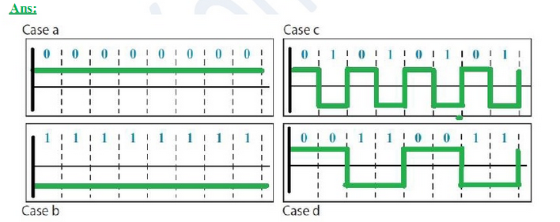
NRZ- L

Slide 31
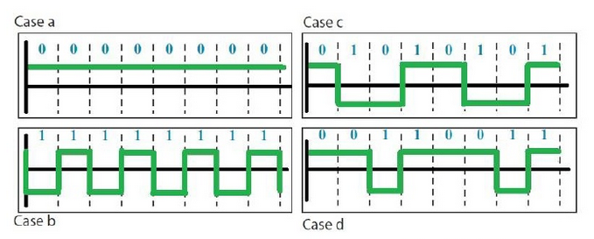
NRZ - I

Slide 32
4.1.2 Line Coding Schemes Contd.
Comparison of these two schemes
Although baseline wandering is a problem for both variations, it is twice as severe in NRZ-L.
If there is a long sequence of 0s or 1s in NRZ-L, the average signal power becomes skewed.
The receiver might have difficulty discerning the bit value.
In NRZ-I this problem occurs only for a long sequence of 0s.
If somehow we can eliminate the long sequence of 0s, we can avoid baseline wandering.
The synchronization problem (sender and receiver clocks are not synchronized) also exists in both schemes.
Again, this problem is more serious in NRZ-L than in NRZ-I. While a long sequence of 0s can cause a problem in both schemes, a long sequence of 1s affects only NRZ-L.

Slide 33
4.1.2 Line Coding Schemes Contd.
Another problem with NRZ-L occurs when there is a sudden change of polarity in the system.
For example, if twisted-pair cable is the medium, a change in the polarity of the wire results in all 0s interpreted as 1s and all 1s interpreted as 0s.
NRZ-I does not have this problem.
Both schemes have an average signal rate of N/2 Bd.
There are DC components that carry a high level of energy.

Slide 34
4.1.2 Line Coding Schemes Contd.
Return-to-Zero (RZ)
The main problem with NRZ encoding occurs when the sender and receiver clocks are not synchronized. The receiver does not know when one bit has ended and the next bit is starting.
One solution is the return-to-zero (RZ) scheme, which uses three values: positive, negative, and zero.
In RZ, the signal changes not between bits but during the bit.
In Figure 4.7 we see that the signal goes to 0 in the middle of each bit.
It remains there until the beginning of the next bit.

Slide 35
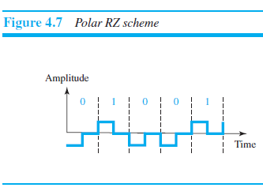
4.1.2 Line Coding Schemes Contd.

Slide 36
4.1.2 Line Coding Schemes Contd.
The main disadvantage of RZ encoding is that it requires two signal changes to encode a bit and therefore occupies greater bandwidth.
Sudden change of polarity resulting in all 0s interpreted as 1s and all 1s interpreted as 0s, still exists here, but there is no DC component problem.
Another problem is the complexity: RZ uses three levels of voltage, which is more complex to create and discern.
As a result of all these deficiencies, the scheme is not used today.
Instead, it has been replaced by the better-performing Manchester and differential Manchester schemes

Slide 37
4.1.2 Line Coding Schemes Contd.
Biphase: Manchester and Differential Manchester
The idea of RZ (transition at the middle of the bit) and the idea of NRZ-L are combined into the Manchester scheme.
In Manchester encoding, the duration of the bit is divided into two halves. The voltage remains at one level during the first half and moves to the other level in the second half.
The transition at the middle of the bit provides synchronization.

Slide 38
4.1.2 Line Coding Schemes Contd.
Differential Manchester, on the other hand, combines the ideas of RZ and NRZ-I.
There is always a transition at the middle of the bit, but the bit values are determined at the beginning of the bit.
If the next bit is 0, there is a transition; if the next bit is 1, there is none.
Figure 4.8 shows both Manchester and differential Manchester encoding.

Slide 39
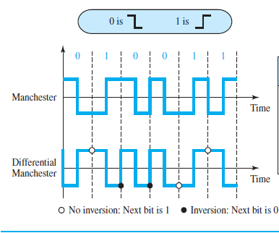
4.1.2 Line Coding Schemes Contd.

Slide 40
Draw the graph of the Manchester, Differential Manchester, using each of the following data streams, assuming that the last signal level has been positive
00000000
11111111
01010101
00110011

Slide 41
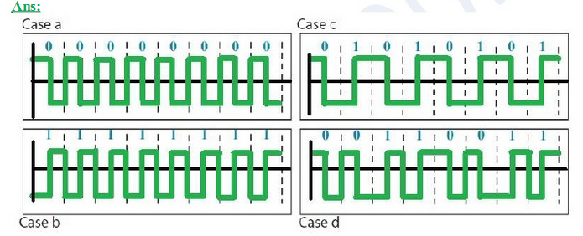
Manchester Scheme

Slide 42
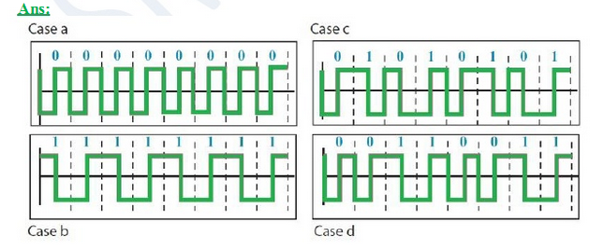
Differential Manchester Scheme

Slide 43
4.1.2 Line Coding Schemes Contd.
The Manchester scheme overcomes several problems associated with NRZ-L, and differential Manchester overcomes several problems associated with NRZ-I.
First, there is no baseline wandering.
There is no DC component because each bit has a positive and negative voltage contribution.
The only drawback is the signal rate.
The signal rate for Manchester and differential Manchester is double that for NRZ.
The reason is that there is always one transition at the middle of the bit and maybe one transition at the end of each bit.
Note that Manchester and differential Manchester schemes are also called biphase schemes.
The minimum bandwidth of Manchester and differential Manchester is 2 times that of NRZ.

Slide 44
4.1.3 Block Coding
We need redundancy to ensure synchronization and to provide some kind of inherent error detecting.
Block coding can give us this redundancy and improve the performance of line coding.
In general, block coding changes a block of m bits into a block of n bits, where n is larger than m.
Block coding is referred to as an mB/nB encoding technique.

Slide 45
4.1.3 Block Coding Contd.
The slash in block encoding (for example, 4B/5B) distinguishes block encoding from multilevel encoding (for example, 8B6T), which is written without a slash.
Block coding normally involves three steps: division, substitution, and combination.
In the division step, a sequence of bits is divided into groups of m bits.
For example, in 4B/5B encoding, the original bit sequence is divided into 4-bit groups.

Slide 46
4.1.3 Block Coding Contd.
The heart of block coding is the substitution step.
In this step, we substitute an m-bit group with an n-bit group.
For example, in 4B/5B encoding we substitute a 4-bit group with a 5-bit group.
Finally, the n-bit groups are combined to form a stream.
The new stream has more bits than the original bits. Figure 4.14 shows the procedure.

Slide 47
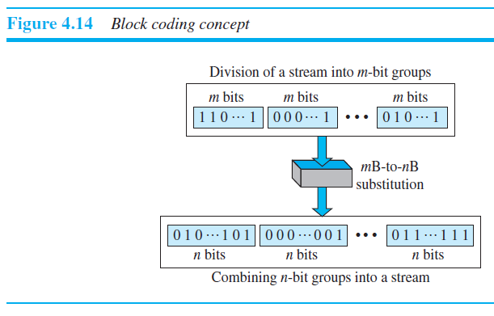
4.1.3 Block Coding Contd.

Slide 48
4.1.3 Block Coding Contd.
4B/5B
The four binary/five binary (4B/5B) coding scheme was designed to be used in combination with NRZ-I.
Recall that NRZ-I has a good signal rate, one-half that of the biphase, but it has a synchronization problem.
A long sequence of 0s can make the receiver clock lose synchronization.
One solution is to change the bit stream, prior to encoding with NRZ-I, so that it does not have a long stream of 0s.

Slide 49
4.1.3 Block Coding Contd.
The 4B/5B scheme achieves this goal.
The block-coded stream does not have more than three consecutive 0s.
At the receiver, the NRZ-I encoded digital signal is first decoded into a stream of bits and then decoded to remove the redundancy.
Figure 4.15 shows the idea.

Slide 50
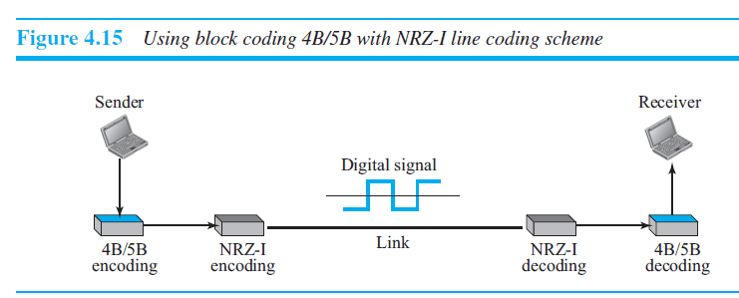
4.1.3 Block Coding Contd.

Slide 51
4.1.3 Block Coding Contd.
In 4B/5B, the 5-bit output that replaces the 4-bit input has no more than one leading zero (left bit) and no more than two trailing zeros (right bits).
So when different groups are combined to make a new sequence, there are never more than three consecutive 0s.
Table 4.2 shows the corresponding pairs used in 4B/5B encoding.
Note that the first two columns pair a 4-bit group with a 5-bit group.
A group of 4 bits can have only 16 different combinations while a group of 5 bits can have 32 different combinations.

Slide 52
4.1.3 Block Coding Contd.
This means that there are 16 groups that are not used for 4B/5B encoding.
Some of these unused groups are used for control purposes; the others are not used at all.
The latter provide a kind of error detection.
If a 5-bit group arrives that belongs to the unused portion of the table, the receiver knows that there is an error in the transmission.

Slide 53
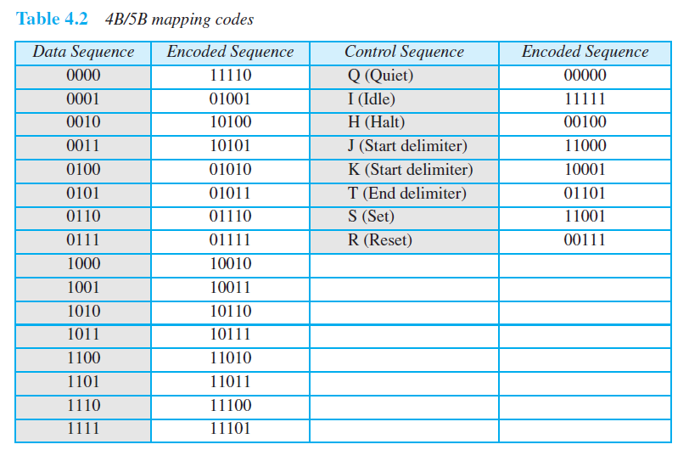
4.1.3 Block Coding Contd.

Slide 54
4.1.3 Block Coding Contd.
Figure 4.16 shows an example of substitution in 4B/5B coding.
4B/5B encoding solves the problem of synchronization and overcomes one of the deficiencies of NRZ-I.
However, we need to remember that it increases the signal rate of NRZ-I.
The redundant bits add 20 percent more baud.
Still, the result is less than the biphase scheme which has a signal rate of 2 times that of NRZ-I.
However, 4B/5B block encoding does not solve the DC component problem of NRZ-I.
If a DC component is unacceptable, we need to use biphase or bipolar encoding.

Slide 55
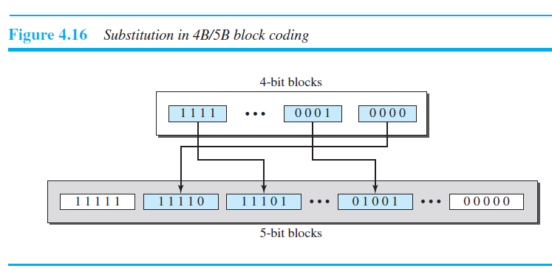
4.1.3 Block Coding Contd.

Slide 56
The input stream to a 4B/5B block encoder is
0100 0000 0000 0000 0000 0001 Answer the following questions:
What is the output stream?
What is the length of the longest consecutive sequence of 0s in the input?
What is the length of the longest consecutive sequence of 0s in the output?

Slide 57

The input stream to a 4B/5B block encoder is
0100 0000 0000 0000 0000 0001 Answer the following questions:
What is the output stream?
What is the length of the longest consecutive sequence of 0s in the input?
What is the length of the longest consecutive sequence of 0s in the output?

Slide 58
How many invalid (unused) code sequences can we have in 5B/6B encoding? How many in 3B/4B encoding?

Slide 59

How many invalid (unused) code sequences can we have in 5B/6B encoding? How many in 3B/4B encoding?

Slide 60
4.2 ANALOG-TO-DIGITAL CONVERSION
Sometimes we have an analog signal such as one created by a microphone or camera.
A digital signal is superior to an analog signal.
The tendency today is to change an analog signal to digital data.
Two techniques used are pulse code modulation and delta modulation.
After the digital data are created (digitization), we can use one of the techniques like line coding, block coding and scrambling to convert the digital data to a digital signal.

Slide 61
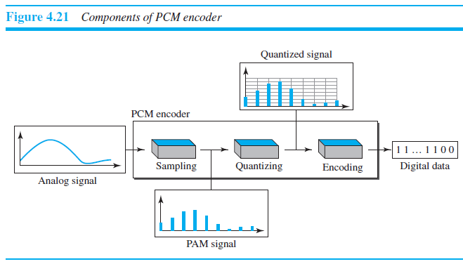
4.2.1 Pulse Code Modulation (PCM)
Changes an analog signal to digital data
A PCM encoder has three processes
1. The analog signal is sampled.
2. The sampled signal is quantized.
3. The quantized values are encoded as streams of bits.

Slide 62
4.2.1 Pulse Code Modulation Contd.
Sampling
The first step in PCM is sampling. Also referred to as pulse amplitude Modulation (PAM).
The analog signal is sampled every Ts seconds, where Ts is the sample interval or period.
There are three sampling methods—ideal, natural, and flat-top
According to the Nyquist theorem, the sampling rate must be at least 2 times the highest frequency contained in the signal.

Slide 63
4.2.1 Pulse Code Modulation Contd.
Quantization
The result of sampling is a series of pulses with amplitude values between the maximum and minimum amplitudes of the signal.
The set of amplitudes can be infinite with nonintegral values between the two limits.
These values cannot be used in the encoding process.
The following are the steps in quantization:
1. We assume that the original analog signal has instantaneous amplitudes between Vmin and Vmax.

Slide 64
4.2.1 Pulse Code Modulation Contd.
As a simple example, assume that we have a sampled signal and the sample amplitudes are between −20 and +20 V.
We decide to have eight levels (L = 8). This means that Δ = 5 V.
Quantization Levels
The choice of L, the number of levels, depends on the range of the amplitudes of the analog signal and how accurately we need to recover the signal.
If the amplitude of a signal fluctuates between two values only, we need only two levels; if the signal, like voice, has many amplitude values, we need more quantization levels.
Choosing lower values of L increases the quantization error if there is a lot of fluctuation in the signal.

Slide 65
4.2.1 Pulse Code Modulation Contd.
Quantization Error
The input values to the quantizer are the real values; the output values are the approximated values.
The output values are chosen to be the middle value in the zone.
If the input value is also at the middle of the zone, there is no quantization error; otherwise, there is an error.
The value of the error for any sample is less than Δ/2. In other words, we have −Δ/2 ≤ error ≤ Δ/2.

Slide 66

4.2.1 Pulse Code Modulation Contd.
The quantization error changes the signal-to-noise ratio of the signal, which in turn reduces the upper limit capacity according to Shannon.
It can be proven that the contribution of the quantization error to the SNRdB of the signal depends on the number of quantization levels L, or the bits per sample nb, as shown in the following formula:

Slide 67
4.2.1 Pulse Code Modulation Contd.
Uniform Versus Nonuniform Quantization
For many applications, the distribution of the instantaneous amplitudes in the analog signal is not uniform.
Changes in amplitude often occur more frequently in the lower amplitudes than in the higher ones.
For these types of applications it is better to use nonuniform zones.
In other words, the height of Δ is not fixed; it is greater near the lower amplitudes and less near the higher amplitudes.

Slide 68
4.2.1 Pulse Code Modulation Contd.
Nonuniform quantization can also be achieved by using a process called companding and expanding.
The signal is companded at the sender before conversion; it is expanded at the receiver after conversion.
Companding means reducing the instantaneous voltage amplitude for large values; expanding is the opposite process.
Companding gives greater weight to strong signals and less weight to weak ones.

Slide 69
4.2.1 Pulse Code Modulation Contd.
Encoding
After each sample is quantized and the number of bits per sample is decided, each sample can be changed to an nb-bit code word.
A quantization code of 2 is encoded as 010; 5 is encoded as 101; and so on.
Note that the number of bits for each sample is determined from the number of quantization levels i.e nb = log2 L. In our example L is 8 and nb is therefore 3.
The bit rate can be found from the formula

Slide 70
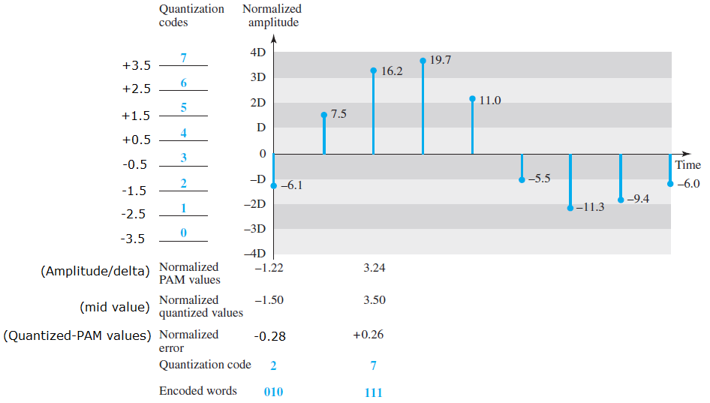

4.2.1 Pulse Code Modulation Contd.
2. We divide the range into L zones, each of height Δ (delta).
3. We assign quantized values of 0 to L−1 to the midpoint of each zone.
4. We approximate the value of the sample amplitude to the quantized values.

Slide 71
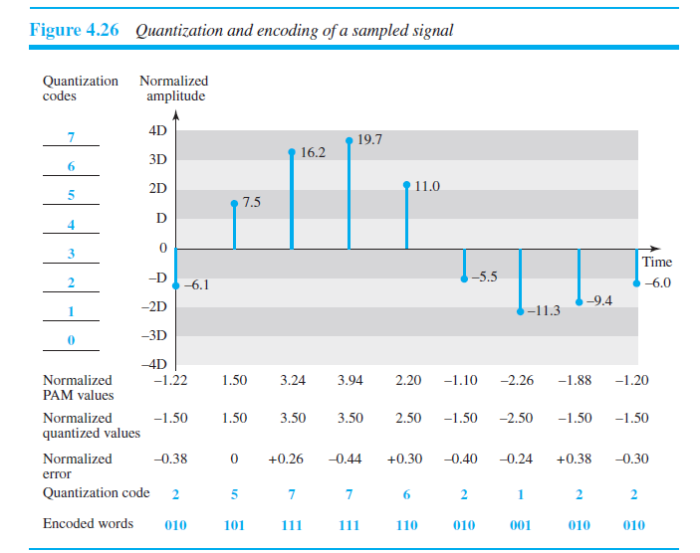
4.2.1 Pulse Code Modulation Contd.

Slide 72
4.2.1 Pulse Code Modulation Contd.
Original Signal Recovery
The recovery of the original signal requires the PCM decoder.
The decoder first uses circuitry to convert the code words into a pulse that holds the amplitude until the next pulse.
After the staircase signal is completed, it is passed through a low-pass filter to smooth the staircase signal into an analog signal.
The filter has the same cutoff frequency as the original signal at the sender.
If the signal has been sampled at the Nyquist sampling rate and if there are enough quantization levels, the original signal will be recreated.

Slide 73
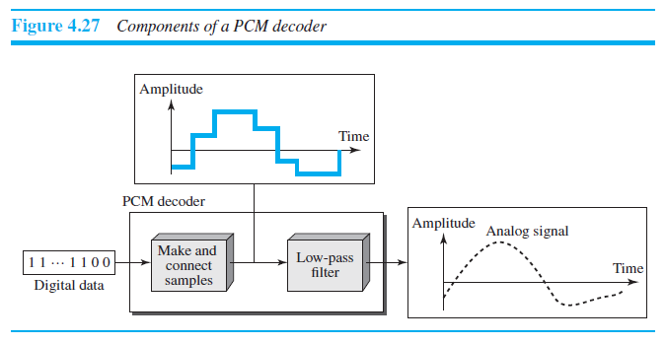
4.2.1 Pulse Code Modulation Contd.

Slide 74
END OF CHAPTER 4

